Slide 1
Pembroke Kennels
Natasha Kee
&
Christina Phan

Slide 2
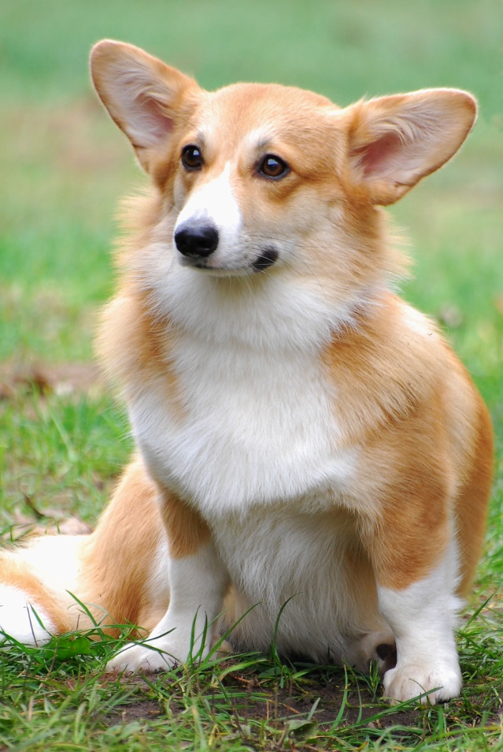
About Pembroke Kennels
Dog Breeder Website : Pembroke Corgis
We wanted to have a fresh
updated theme to the many
obsolete themes we
researched for other dog
breeder sites.
Make a breeder site that was
interactive online.

Slide 3
Other Dog Breeding Sites
The problem:
Outdated design
Messy interface
Hard to navigate
Often tacky color themes

Slide 4
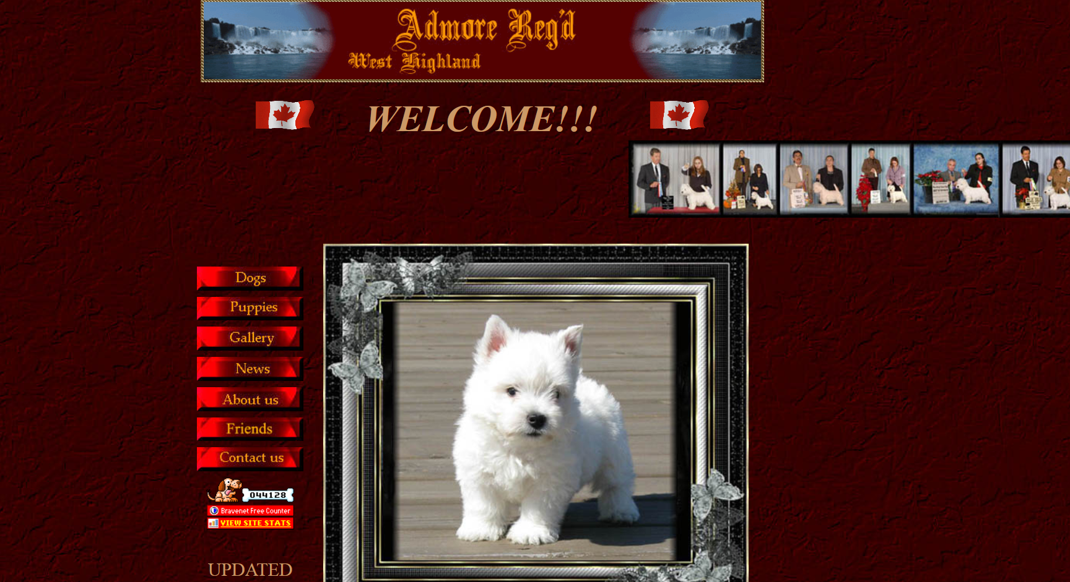

Slide 5
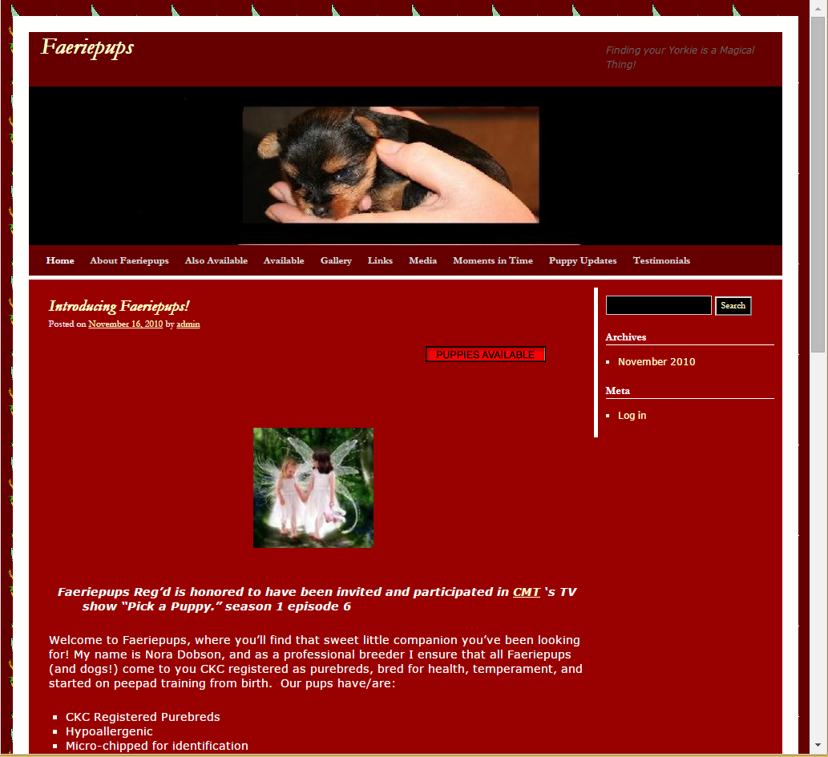

Slide 6
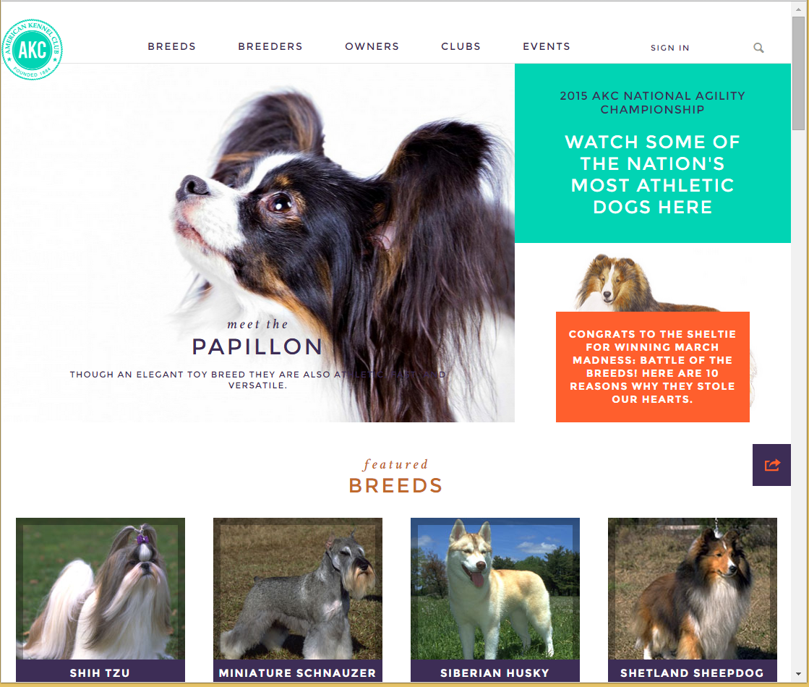

Slide 7
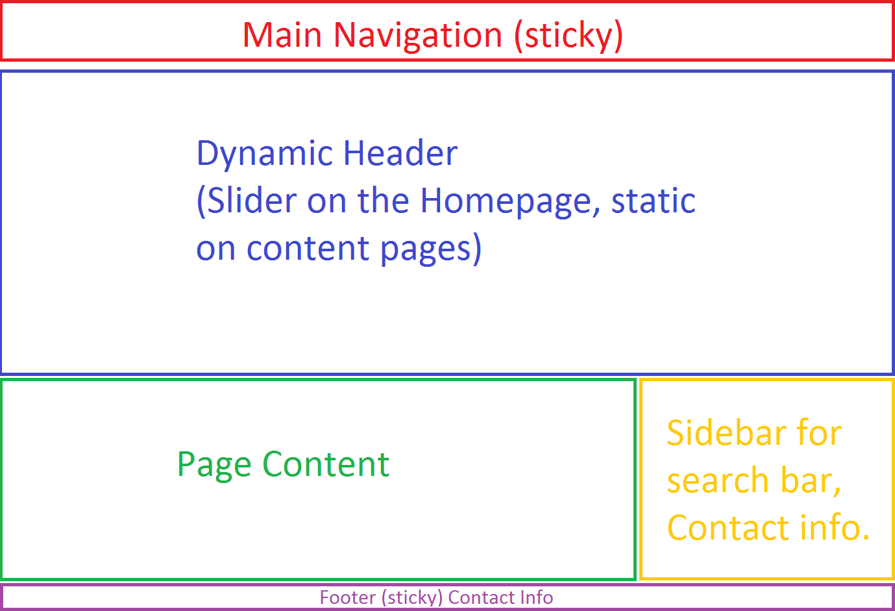

Slide 8
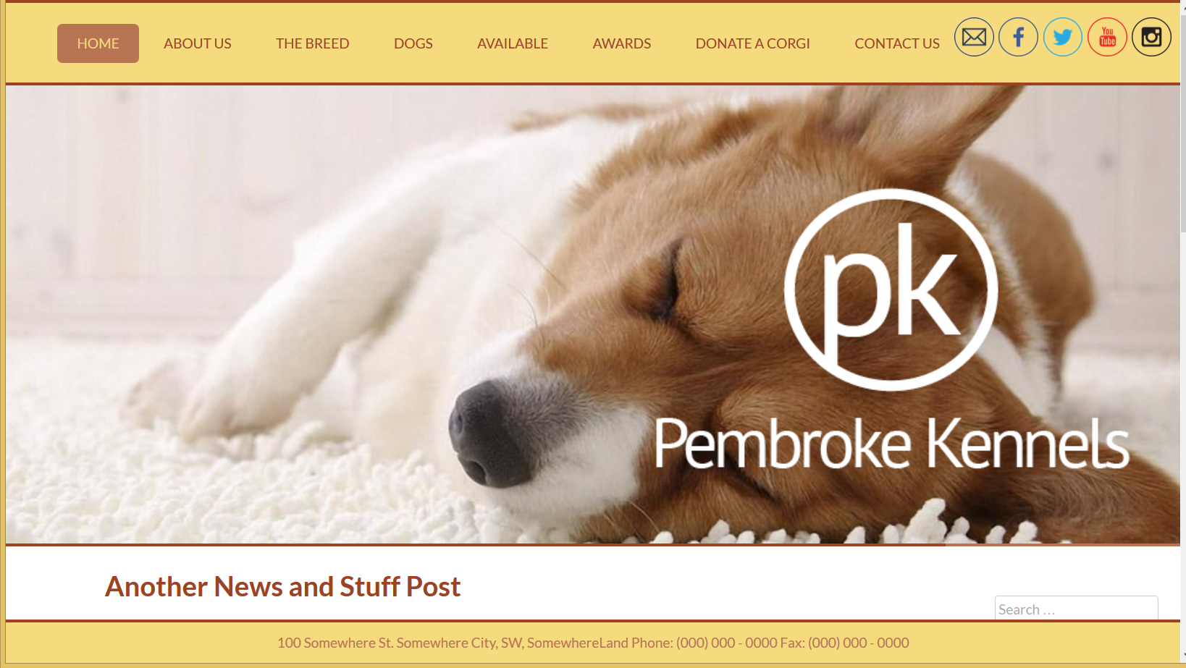

Slide 9
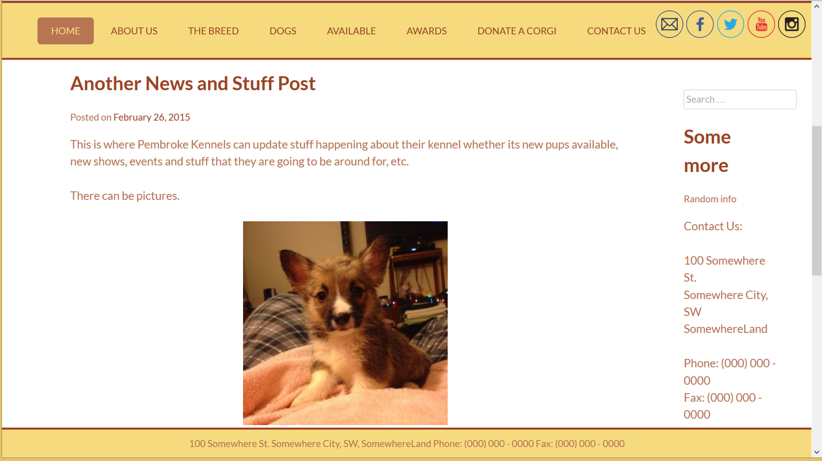

Slide 10
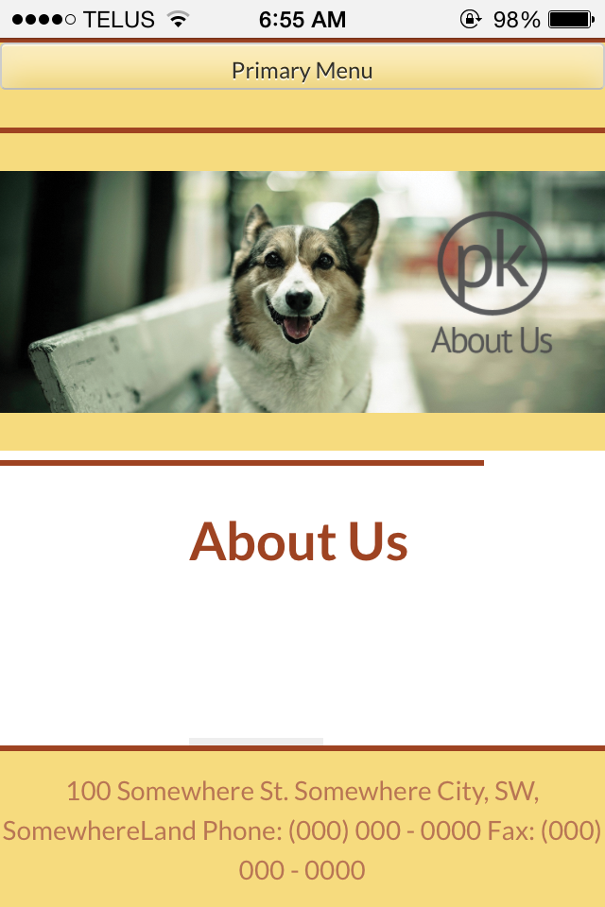

Slide 11
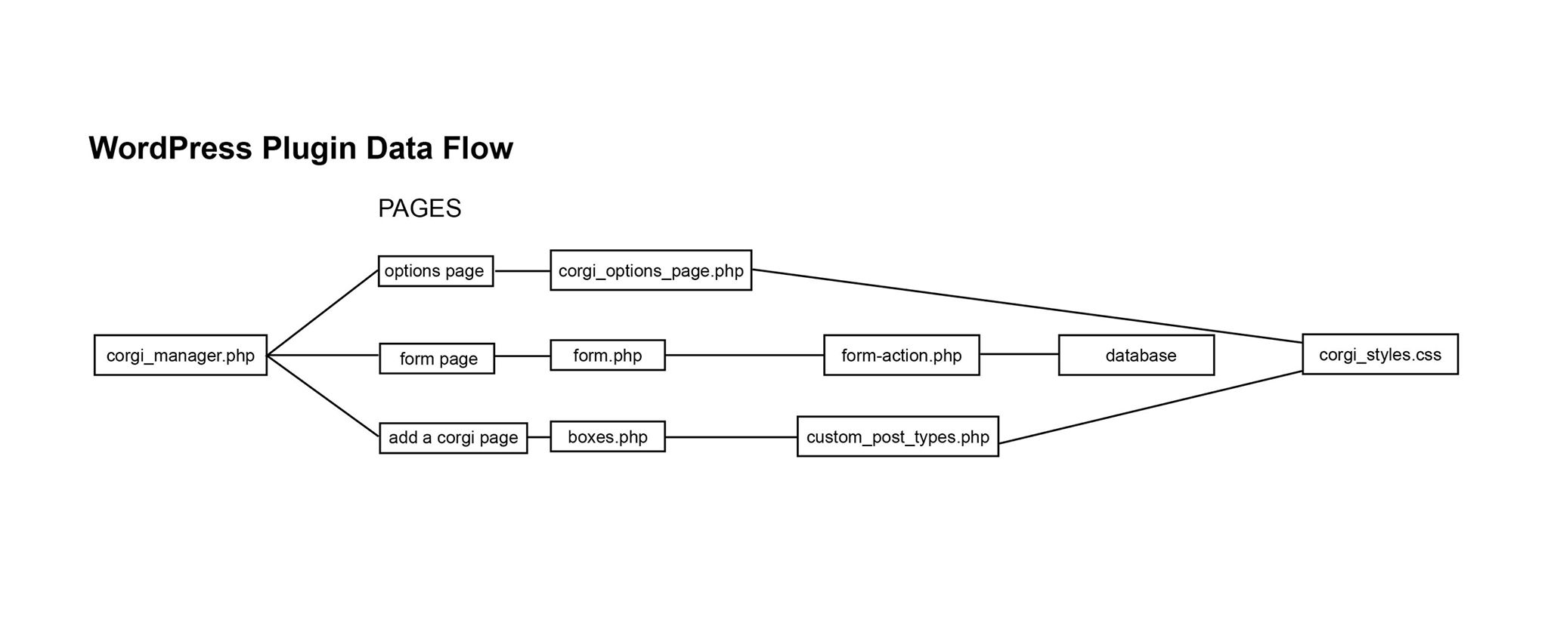

Slide 12
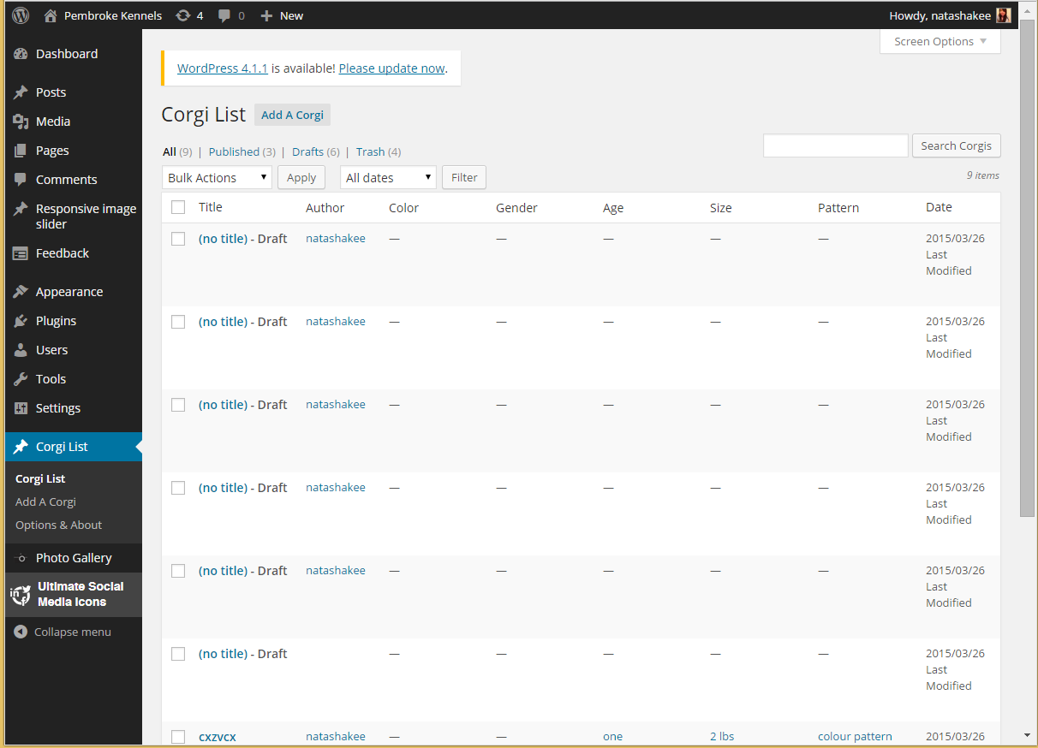

Slide 13
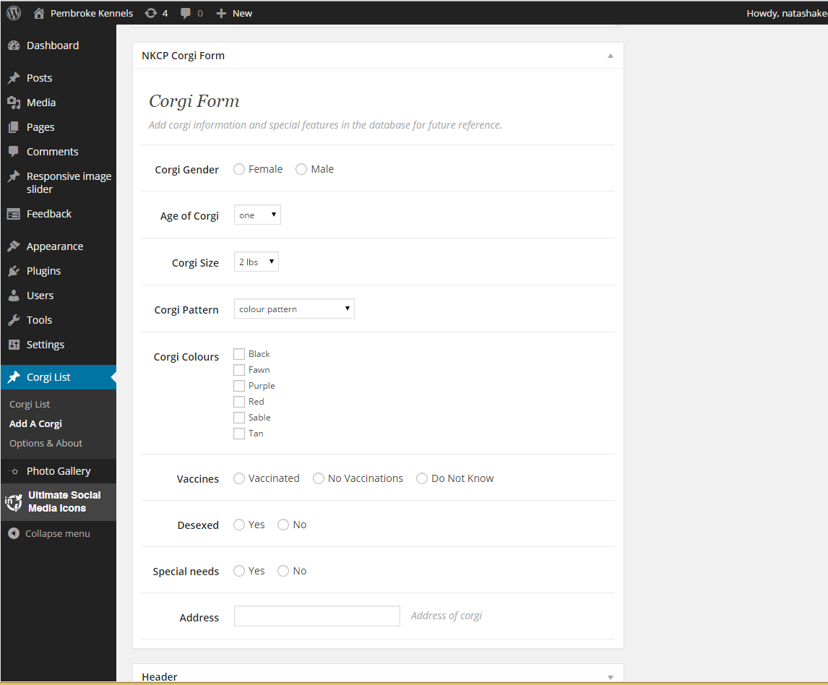

Slide 14
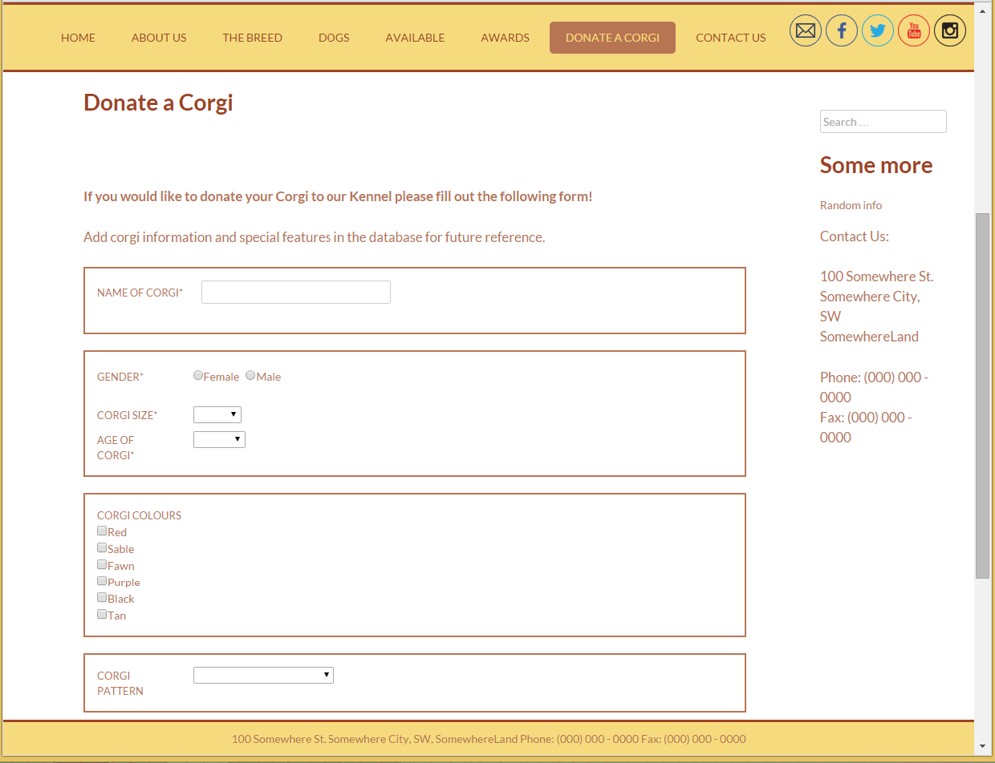

Slide 15
Future Development
Search engine for the database.
Allows users to search for specific characteristics they are looking for to adopt their own corgi from the site.

Slide 16
FIN – Thank you for listening

